Slide 1
Courant Math 2799.001
Modeling & Risk Mgt of Bonds & Securitized Products
Lecture 6: Corporate Lending, CLOs
April 29, 2024
Prof: Rodney Sunada-Wong rsw8@nyu.edu
TA: Edison Lee el2700@nyu.edu

Slide 2
Topics
Corporate Lending: Basic Definitions
Investment Grade Loans vs Leveraged Loans
Syndication and Loan Trading
What is a CLO?
Appendix
Leveraged Loan trends
CLO trends

Slide 3
Corporate Loans: Definitions
Corporate Lending = Wholesale Lending
= Commercial and Industrial (“C&I”) Lending
= Syndicated Lending
Facility: debt instrument under which loans are provided
Commitments = Credit Line
= Lender’s Obligation to Lend in the future (similar to a Credit Card)
vs.
Loans = Money that is actually lent to the Borrower
= Funded Commitment
= Drawn Amount
Lenders: Typically Banks: Bank of America, Citi, JPMorgan, Wells Fargo, etc.
But also: Jefferies, KKR etc.
Borrowers: Wal-Mart, Abbott Labs, PetSmart, etc.
+ Tax-Exempts, Financials, SPVs (sometimes)
Generally, >$50MM in EBITDA (if smaller, known as “Middle Market”)

Slide 4
Two Key Market Segments: Investment Grade Loans vs Leveraged Loans
Capital Structure
Investment grade loan market
Loans to companies rated >= BBB-/Baa3
AND with a relatively low LIBOR spread
Loan is usually unsecured
Ranked pari passu with bonds
Sr.
Unsec’d
Loan
Sr.
Unsec’d
Bond
Equity
Leveraged Loan market
Loans to companies rated <= BB+/Ba1 or unrated
AND with a spread >= LIB+[175] bps
Loan is usually secured
Senior to all other debt
Sr. Sec’d
Loan
Sub. Unsec’d
Bond
Equity
Illustrations Credit: Thomson Reuters LPC

Slide 5
Leveraged Lending Overview
What is Leveraged Lending?:
Type of corporate finance used for M&A and Leveraged Buyouts (LBOs), business recapitalization and refinancing, and business or product line build-outs and expansions
Leveraged Lending is more prevalent in large banks (not small banks), and typical players involve corporates and financial sponsors
LBO trends as of 2018:
At $156Bn as of June 2018, LBO volume in 2018 was on pace to have highest dollar volume of LBOs since 2007 and is 44% higher than 2017 comparable level, according to Dealogic
As of June 2018, more than $2.1 trillion in M&A deals have been announced this far, up 56% vs. prior year
Firms such as Blackstone Group, KKR and Carlyle are collectively sitting on more than $1 trillion of cash that they must invest to collect lucrative fees from their investors
Biggest LBO deals so far in 2018: (i) Blackstone Group’s purchase of Thomson Reuters’ Financial and Risk business for $17Bn; (ii) Carlyle Group’s purchase of Azko Nobel’s Specialty Chemicals business for $12.5Bn; (iii) KKR buying Envision Healthcare Corp for $9.9Bn; and (iv) KKR buying BMC Software for $8.3Bn

Slide 6
Corporate Loans – Structures, Summary
Investment Grade
Leveraged
Generally structured as revolvers
Relationship loan – banks participate for shot at bidding for more lucrative business
Often used to “backstop” commercial paper -- A guarantee that if a borrower is unable to “roll over” its commercial paper, it can draw on this loan to repay the CP
Mostly unfunded – if funds are drawn, it probably means there is a problem!
Generally unsecured and pari passu with bonds
Generally one or two financial covenants
May have a “term-out option” – eg, for a fee the company can draw down on the loan and extend it for a year or two
Generally structured with a revolver and one or more term loans
Revolvers & TLA: Sold to banks and finance companies
TLB: Sold to CLOs, hedge funds, finance companies, loan mutual funds, credit opportunity funds, insurance companies, etc.
Generally senior and secured (by PP&E, not liquid “collateral”)
Generally have many covenants and restrictions
Unlike a bond, most leveraged loans can be repaid at par (100 cents on the dollar) at any time
In tighter loan market conditions (ie 2009/2010) loans can have soft/hard call provisions

Slide 7
Corporate Loans – Structures
Corporate Loans are:
Floating rate (LIBOR + Credit Spread)
Generally 1 (or 364-days) to 8 years in Tenor
Investment Grade (corporate ratings of BBB-/Baa3 and higher) Structures:
$100 million revolver
$100 million TLA (Term Loan A)
Repay
$25M
Draw down
$20M
Repay
$35M
Draw down
$10M
Draw down $100M
Repay $12.5M
Repay $12.5M
Repay $15M
Repay $20M
Repay
$25M
Repay $15M
Repay $25M
Draw down
$15M
Draw down
$40M
Unsecured
GCP (General Corporate Purposes) or CP Backstop
Supports Letters of Credit
Insurance/Liquidity/Rainy Day Fund
Unsecured
Generally purpose driven (M&A)
Prepayable at par
Amortizes
Illustrations: Thomson Reuters LPC

Slide 8
Corporate Loans – Structures
Corporate Loans are:
Floating rate (LIBOR + Credit Spread)
Generally 1 (or 364-days) to 8 years in Tenor
Non Investment Grade (corporate ratings of BB+/Ba1 and lower) Structures:
$100 million revolver
$100 million TLB
Repay
$25M
Draw down
$20M
Repay
$35M
Draw down
$10M
Outstandings ($Mils.)
Draw down $100M
Repay $1M
Repay $1M
Repay $94M
Repay $1M
Repay $1M
Repay
$25M
Repay $1M
Repay $1M
Draw down
$15M
Draw down
$40M
Secured
GCP and Working Capital
Supports Letters of Credit
Liquidity
Secured
Generally purpose driven (M&A)
May be prepayment penalties
(generally only in years 1-3)
Amortizes at 1% per annum
Illustrations: Thomson Reuters LPC

Slide 9
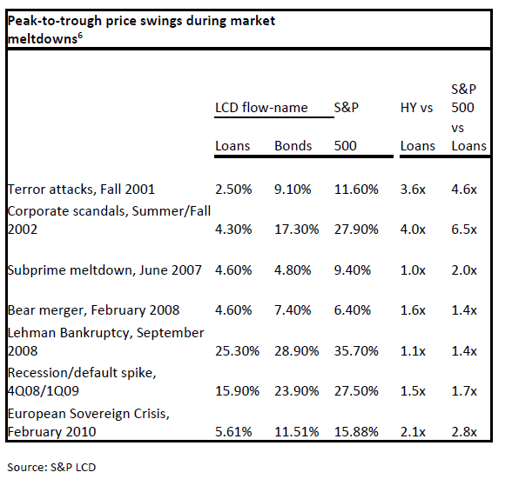
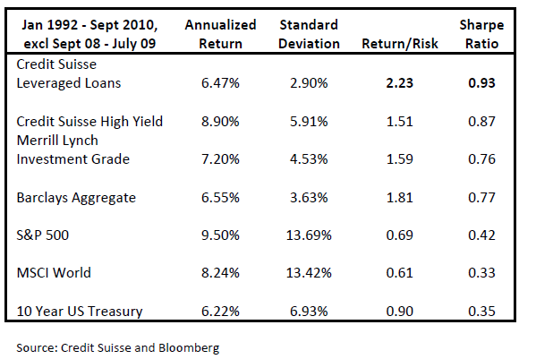
Corporate Loans – Leveraged Loans as an Asset Class
Historical leveraged loan performance has been characterized by lower volatility and a high risk/return profile
Drivers: seniority, security, liquidity, duration

Slide 10
Corporate Loans – Structures, Credit Agreements
A legal contract negotiated between the lender(s) and borrower outlining the terms under which loans will be extended and repaid under the facility. All credit agreements are, to some degree, bespoke, but most adhere (more or less) to the following outline
Sections:
1 - Definitions: list of defined (Capitalized) terms in the agreement with description of each
2 - Amount and terms of the credit: how much can be borrowed and under what terms (interest rate)
3 - Representations and Warranties: list of items the Borrower represents are true (compliance with laws)
4 - Conditions Precedent: requirements of the Borrower to use the facility (legal opinions received)
5 - Affirmative Covenants: things the Borrower must do (payment of interest)
6 - Negative Covenants*: things a Borrower is not allowed to do (e.g. minimum interest coverage ratio)
7 - Events of Default: things that cause the company to be in default (failure to pay interest)
8 - Miscellaneous: typically boilerplate language re: administrative matters (role of the agent banks)
* See appendix for more details

Slide 11
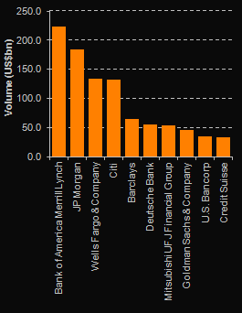
Loan Syndication and Loan Trading
Syndication: Loans is broken into pieces and sold to several lenders
Lead arranger: arranges loan and theoretically holds the biggest piece; typically also the Admin Agent
The Syndicate: holds the remainder
$200 million loan
Lead arranger:
Holds $40 million
Lender A:
$30M
Lender J:
$10M
Lender B:
$30M
Lender H:
$10M
Lender C:
$30M
Lender G:
$10M
Lender D:
$20M
Lender F:
$10M
Lender E:
$10M
In this example, other lenders hold $160MM
All Loans League Table 1Q-3Q2016
Illustrations Credit: Thomson Reuters LPC

Slide 12
Corporate Loans – Post Syndication: Loan Trading
Up to $25MM Funding Obligation
Borrower
Interest, Fees, Repayments on $25MM
Lender of Record
Trading
Typically, there is very little trading of Investment Grade loans
still largely a “buy and hold” market
economics of unfunded revolvers (whoever owns the revolver has to be ready to fund it)
relationship restrictions
The majority of loan trading is trading of Leveraged Loans
A long-only market – loans are not securities so they can’t be borrowed (no shorting)
Loans are not listed on exchanges (unlike listed equities)

Slide 13
Corporate Loans – Post Syndication: Loan Trading
The primary mechanism for selling a loan to another lender is via “Assignment”
Both the Borrower and the Agent have to consent to a loan being assigned
Minimum assignment amounts: $1-10MM
Up to $25MM Funding Obligation
Borrower
X
Lender of Record
Interest, Fees, Repayments on $25MM
X
New Lender of Record
Another method to sell a loan to another lender is via “Participation”
The lender of record enters into an agreement with another party whereby the economics are passed to the other party
The Seller continues to be the lender of record; The sale of the loan is a “synthetic” sale.
No consent is required
No minimums
Up to $25MM Funding Obligation
Up to $12MM Funding Obligation
Borrower
Interest, Fees, Repayments on $25MM
Lender of Record
$1MM + Interest, Fees, Repayments on $12MM
Participation Buyer

Slide 14
What is a CLO?
A CLO is a type of securitization:
A CLO involves the practice of pooling leveraged loans into a CLO fund.
The CLO fund is set up as a special purpose vehicle (SPV), and the cashflows are securitized into debt and equity-like tranches to sell to various investors.
Loan #1
Assets
Liabilities
Loan #2
100 loans
Security A
Investors
Security B
*
*
*
*
Loan #3
Equity
Loan #100
In essence, the CLO debt tranches collectively provide structural leverage to the equity tranche to gain levered exposure to a pool of diversified leveraged loans.

Slide 15
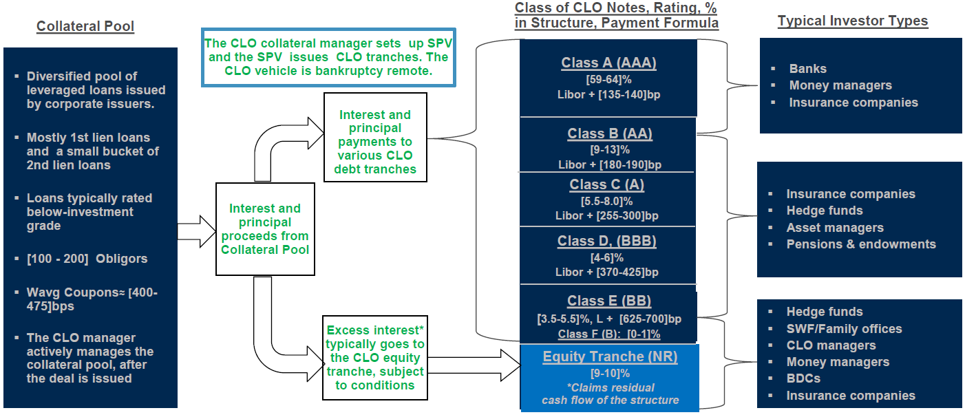
What is a CLO?
CLOs are actively managed funds:
The vast majority of CLOs, which are arbitrage CLOs, have a collateral manager who actively manages the collateral pool after the CLO deal is issued.
Therefore, the makeup of a CLO collateral pool changes throughout its reinvestment period of 4-5 years.

Slide 16
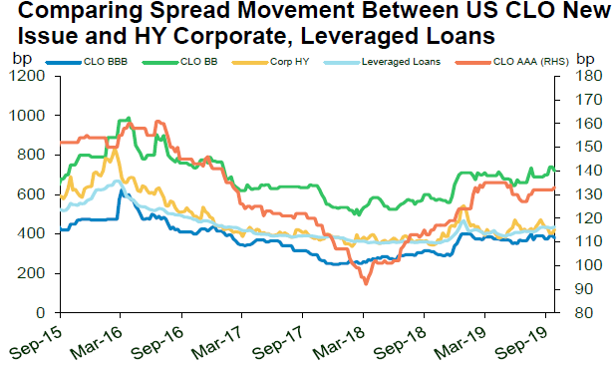
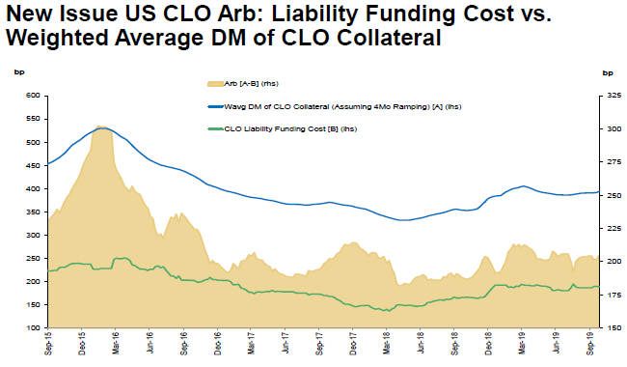
CLO trends
CLOs issuance globally is primarily driven by “the arb”.
But a portion of the loans in CLOs may be because banks originated leveraged loans and want to get it off their balance sheet.
Source: CLO Tracker October 2019” Oct 7, 2019, Charlie Wu, James Egan p8

Slide 17
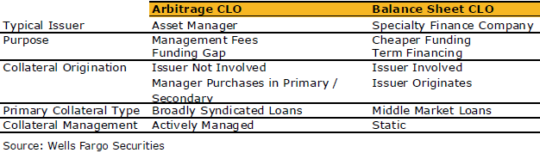
CLO types
Assets are corporate loans
Typically senior secured loans with sublimits on high-yield bonds and second-lien loans
Yields may be boosted by including middle-market loans
Typically floating
Arbitrage CLO vs Balance Sheet CLO
Motivations for creating CLO: Funding gap (arbitrage) vs. Balance Sheet relief
Funding Gap = Asset Spread – Expenses – Default Loss – Liability Spread
Actively Managed (reinvestment period) vs. Static (amortize)
Cash vs. Synthetic vs. a hybrid
Actual loans in SPV vs Credit Derivatives linked to loans
The vast majority are actively managed Arbitrage CLOs
Mostly first lien loans; small bucket of second lien loans
100-200 obligors

Slide 18
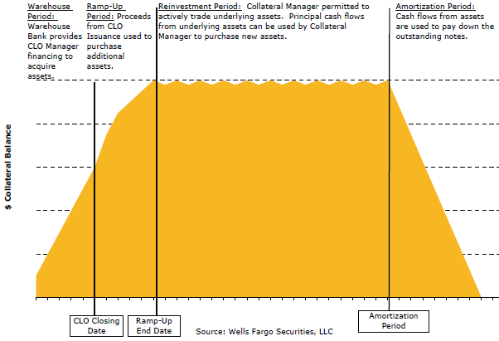
CLO timeline
Reinvestment period
Pre-Financial Crisis 5-7yrs;
post-Financial Crisis: 1 to 3 years
Optional redemption call
Equity holder has right to redeem notes
Since principal is reinvested, if loan spreads tighten, funding gap can tighten

Slide 19
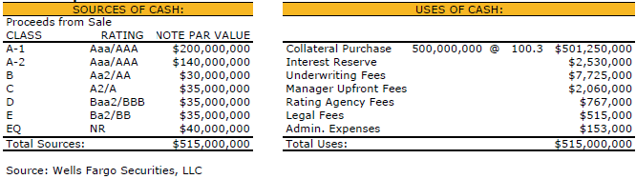
CLO (sources and uses of cash)

Slide 20
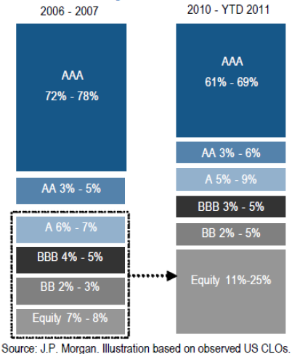
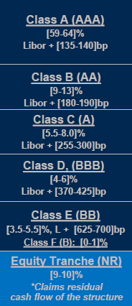
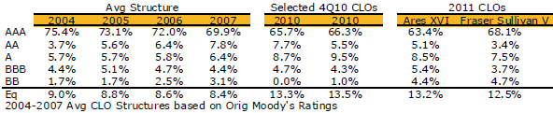
CLO – change in structural protection pre-crisis vs post-crisis
Structural Protection for AAA:
Pre-crisis: 25% - 30%
CLO 2.0: 30% - 35%
2016
Source:
Morgan Stanley

Slide 21
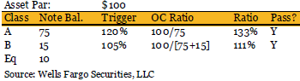
CLO performance tests
OC (Over-collateralization) test
Par-based OC test based on
“Adjusted collateral par value” =
Performing Collateral Par Value
- haircuts
+ Cash
+ (Defaulted Collateral Par Value × Recovery Rate).
If triggered, then excess interest diverted from subordinated notes to pay down senior notes until OC test is in compliance

Slide 22
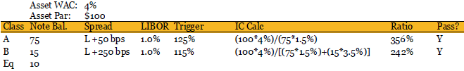
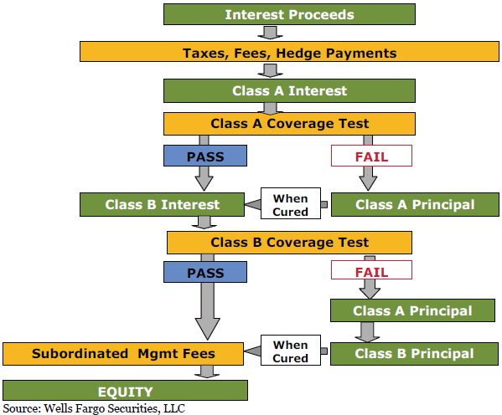
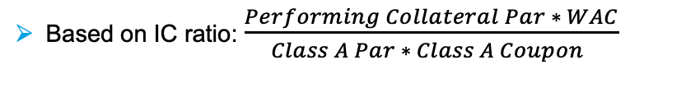
CLO performance tests
Interest Coverage Test
Based on IC ratio: $\frac{Performing Collateral Par ∗ WAC}{Class A Par ∗ Class A Coupon }$
Source: S&P Leveraged Loan Index Report – Jan 2014

Slide 23
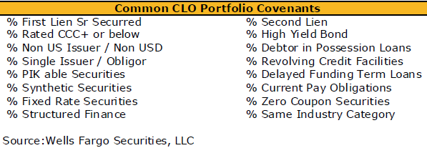
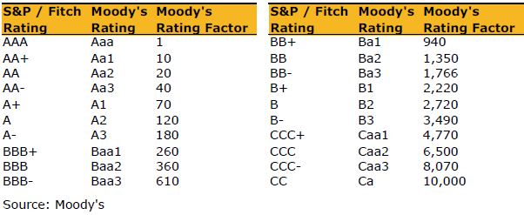
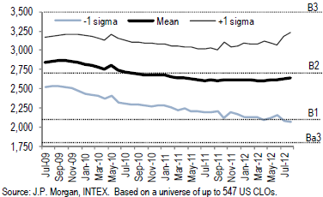
CLO performance tests
Quality tests –
If breached, manager may not trade except to remediate test
Diversity Score
Weighted-Average Spread (WAS)
Investment Criteria
Weighted-Average-Rating Factor (WARF)

Slide 24
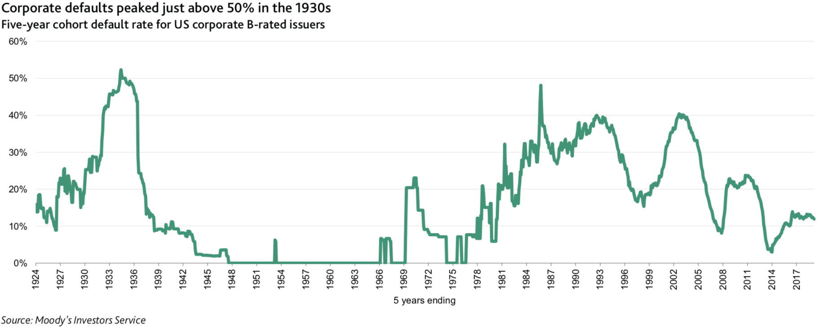
Lending Trends: credit performance
Moody’s Five-Year Cohort Default Rate (does not take into account Loss Given Default)
Source: Moody’s Sector Comment CLO Global 20Apr20

Slide 25
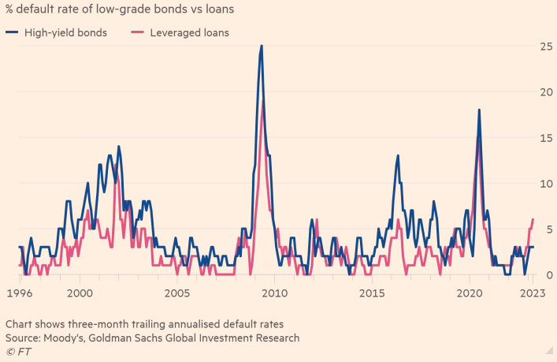
Lending Trends: credit performance
High-Yield Bonds vs Leveraged Loans – three—month trailing annualized default rates
Source: Financial Times, Moody’s Goldman Sachs Global Investment Research
https://www.ft.com/content/84c7f8a2-9e93-4f42-a8b8-bf5d225d8ca8

Slide 26
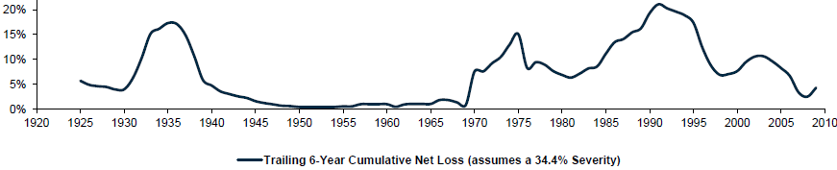
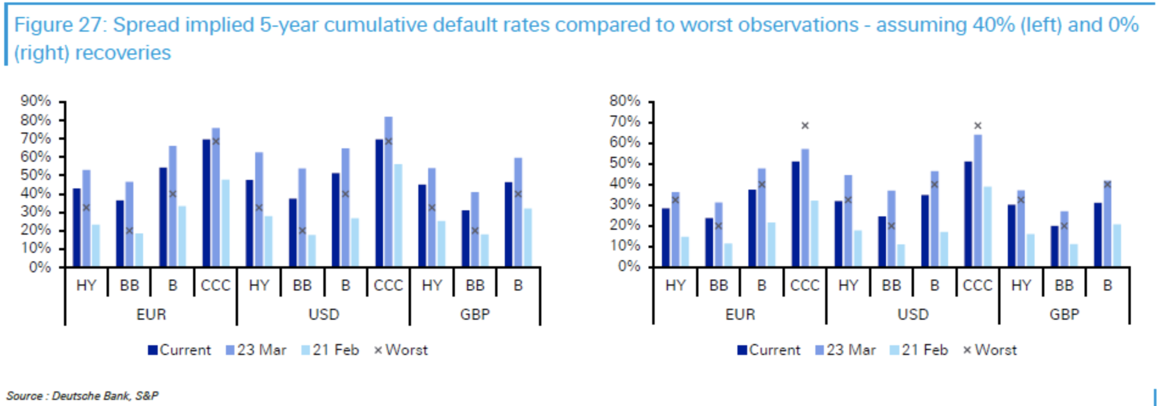
Lending Trends: credit performance
Moody’s B-rated Corporate Loans
Source: Deutsche Bank Default Study April 2020

Slide 27
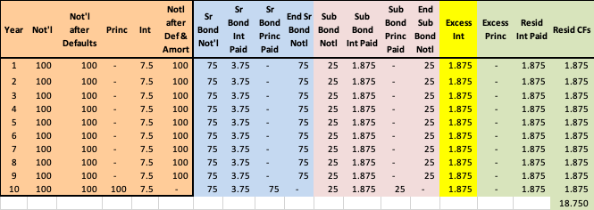
Toy CLO Structure
1) Senior/Subordinate with Residual
Assets: $100MM notional, 7.5% coupon
Senior: $75MM, 5%
Sub: $25MM, 7.5%
Bond-owners: happy
Resid-owner: very happy
Notes:
Whole loan – dollar of loss impacts investor dollar for dollar
Subordination –
under default, losses first hit subordination
no default, principal CF pro-rata or sequentially (senior-sub)
which will rating agencies require greater subordination –
Q to ask: if 90/10 and another 93/7, then which one pro-rata, which one sequential
if sequential, then subordination increases
if time sequential, then earlier tranches are higher quality
if subordinates eaten through, then time sequentials will be collapsed and become pro-rata
OC – as time goes by OC increases; excess interest is used to pay down senior bonds; OC increases until reaching a certain level
WRAP – does not wrap the whole deal e.g. only above a certain rating e.g. A.
MBIA wraps it and is downgraded, but collateral is performing well
what happens to rating of bond – downgraded
Some investors won’t buy if they have too much exposure to an insurer
Reserve – initial amount builds up to a certain level; above that then pays equity
size is a function of rating agency requirements
How do we choose which one to issue? Whichever gives maximum proceeds

Slide 28
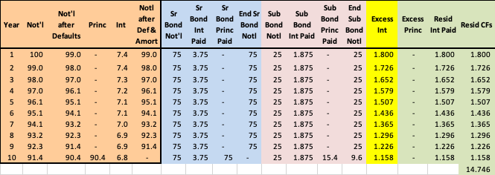
Toy CLO Structure
2) Assuming
1% annual default rate
0% recovery
Sr: happy
Sub: not happy
Resid: rather happy
Notes:
Whole loan – dollar of loss impacts investor dollar for dollar
Subordination –
under default, losses first hit subordination
no default, principal CF pro-rata or sequentially (senior-sub)
which will rating agencies require greater subordination –
Q to ask: if 90/10 and another 93/7, then which one pro-rata, which one sequential
if sequential, then subordination increases
if time sequential, then earlier tranches are higher quality
if subordinates eaten through, then time sequentials will be collapsed and become pro-rata
OC – as time goes by OC increases; excess interest is used to pay down senior bonds; OC increases until reaching a certain level
WRAP – does not wrap the whole deal e.g. only above a certain rating e.g. A.
MBIA wraps it and is downgraded, but collateral is performing well
what happens to rating of bond – downgraded
Some investors won’t buy if they have too much exposure to an insurer
Reserve – initial amount builds up to a certain level; above that then pays equity
size is a function of rating agency requirements
How do we choose which one to issue? Whichever gives maximum proceeds

Slide 29
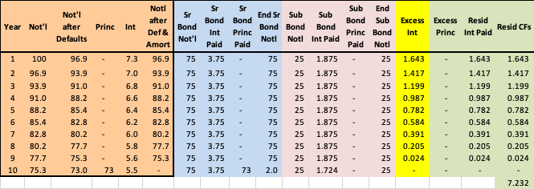
Toy CLO Structure
3) Assuming
3.1% annual default rate
0% recovery
Sr: not happy
Sub: not happy
Resid: somewhat happy
Notes:
Whole loan – dollar of loss impacts investor dollar for dollar
Subordination –
under default, losses first hit subordination
no default, principal CF pro-rata or sequentially (senior-sub)
which will rating agencies require greater subordination –
Q to ask: if 90/10 and another 93/7, then which one pro-rata, which one sequential
if sequential, then subordination increases
if time sequential, then earlier tranches are higher quality
if subordinates eaten through, then time sequentials will be collapsed and become pro-rata
OC – as time goes by OC increases; excess interest is used to pay down senior bonds; OC increases until reaching a certain level
WRAP – does not wrap the whole deal e.g. only above a certain rating e.g. A.
MBIA wraps it and is downgraded, but collateral is performing well
what happens to rating of bond – downgraded
Some investors won’t buy if they have too much exposure to an insurer
Reserve – initial amount builds up to a certain level; above that then pays equity
size is a function of rating agency requirements
How do we choose which one to issue? Whichever gives maximum proceeds

Slide 30
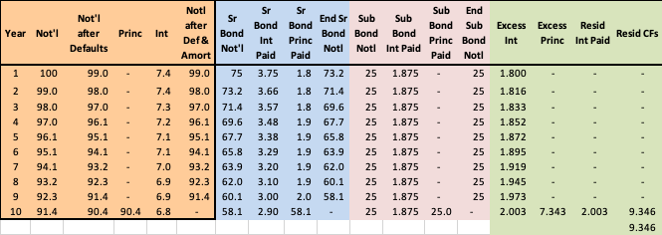
Toy CLO Structure
4) Assuming
1% annual default rate
0% recovery
Excess Interest used to pay down Senior Bond
Sr: happy
Sub: happy
Resid: somewhat happy
Notes:
Whole loan – dollar of loss impacts investor dollar for dollar
Subordination –
under default, losses first hit subordination
no default, principal CF pro-rata or sequentially (senior-sub)
which will rating agencies require greater subordination –
Q to ask: if 90/10 and another 93/7, then which one pro-rata, which one sequential
if sequential, then subordination increases
if time sequential, then earlier tranches are higher quality
if subordinates eaten through, then time sequentials will be collapsed and become pro-rata
OC – as time goes by OC increases; excess interest is used to pay down senior bonds; OC increases until reaching a certain level
WRAP – does not wrap the whole deal e.g. only above a certain rating e.g. A.
MBIA wraps it and is downgraded, but collateral is performing well
what happens to rating of bond – downgraded
Some investors won’t buy if they have too much exposure to an insurer
Reserve – initial amount builds up to a certain level; above that then pays equity
size is a function of rating agency requirements
How do we choose which one to issue? Whichever gives maximum proceeds

Slide 31
Homework

Slide 32
Homework:
This slide was updated after lecture
Build monthly cash flow model with
Assets: 100mm collateral paying 7%
Liabilities: 75mm class A paying 6%, 20mm15mm class B paying 9%, 5mm10mm Equity class
1) Build model without an OC test with the following scenarios
0% annualized default rate
1% annualized default rate (solve for the monthly default rate)
Find the annualized default rate that causes the B class to lose ~$1 of principal
Find the annualized default rate that causes the A class to lose ~$1 of principal
2) Build model with with the same four scenarios (a, b, c, d), but with a par-based OC test
Test the A with a 120% trigger based on Not’l After Defaults / A Class Not’l
Test the B with a 105% trigger based on Not’l After Defaults / (A Class Notl + B Class Not’l)
Follow the waterfall logic on the previous page. For example,
interest received is used to pay the A class’s interest
While the A class test fails
interest received in excess of 1) is used to pay down the A class’s principal until the test is ”in compliance”
if interest received is more than required to satisfy 1), and if the A class test passes, then interest received in excess of 1) and 2a) is used to pay the B class’s interest
etc

Slide 33
Appendix
More details about Leveraged Lending

Slide 34
CLOs: After pandemic, will there be default losses?
Moody’s commentary:
US:
newly issued Baa3 (sf)-rated CLO tranche would require cumulative collateral default rates in the neighborhood of 54% before suffering losses, assuming a 60% recovery rate.
A2 (sf)-rated: 57%-70%, 60% recovery rate, before experience a credit loss.
Aa (sf)-rated
70%-80%, 60% recovery rate
56%-70% in a 50% recovery rate
depending on type of downturn and deal structure.
Source: Moody’s Sector Comment CLO Global April 20, 2020 ; https://www.moodys.com/researchdocumentcontentpage.aspx?docid=PBS_1222301

Slide 35
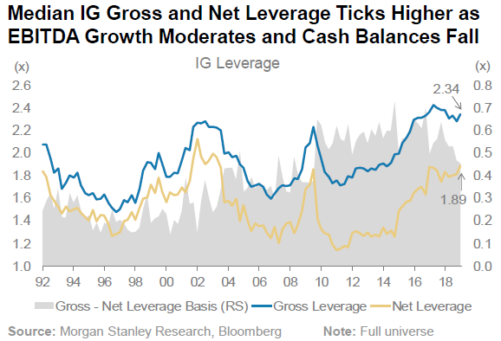
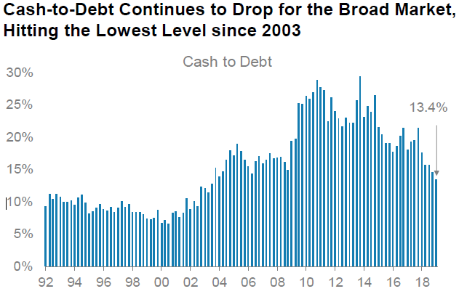
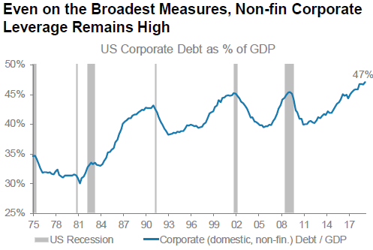
Investment Grade (IG): Gross and Net Leverage
For companies whose debt is investment grade:
Gross Leverage: Debt / EBITDA near all time peak (note Debt includes Loans and Bonds)
Net Leverage: (Debt - Cash) / EBITDA at 15-year peak
As Cash / Debt declined to 2003 levels
Drivers of decrease in Cash/Debt:
CapEx*, Stock buybacks, Dividends, Tighter margins
US corporate debt-to-GDP is at an all-time high
* CapEx: “Capital Expenditures”: funds used by a company to acquire, upgrade, and maintain physical assets such as property, buildings, an industrial plant, technology, or equipment. CapEx is often used to undertake new projects or investments by the firm.
Sources: 1Q19 US Credit Fundamental Review” June 17, 2019, Vishwas Patkar, p3, 6, 7

Slide 36
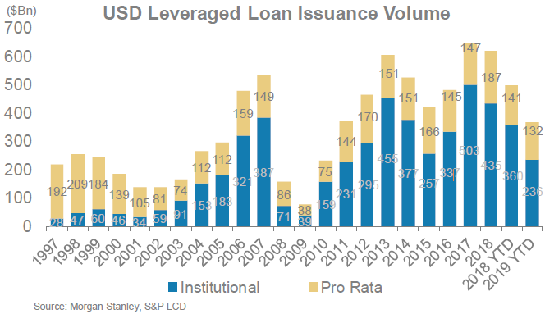
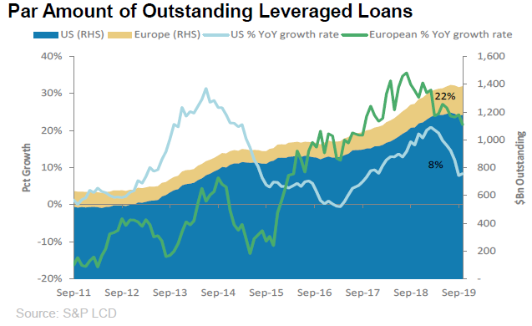
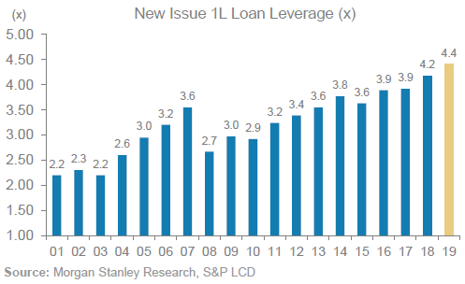
Leveraged Loan: Issuance and Outstanding
Issuance is down from historic highs in 2017:
Par amount of Leveraged Loans grew
8% in the U.S.
22% in Europe
New Issue Loan Leverage at all-time highs
“Institutional”: Term Loan B’s that are more likely traded or syndicated away to institutional investors e.g. CLO’s
“Pro Rata”: Banks hold revolvers and Term Loan A’s which are pari pasu and share same collateral pool
Source: Morgan Stanley “US Corporate Credit Strategy ChartBook” Sept 30, 2019, Srikanth Sankaran p31, p19, ”CLO Tracker October 2019” Oct 7, 2019, Charlie Wu p24, 1Q19 US Credit Fundamental Review” June 17, 2019, Vishwas Patkar, p19

Slide 37
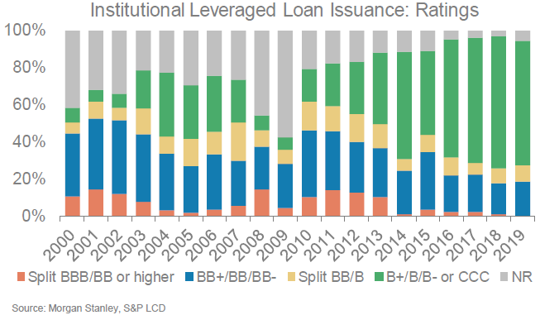
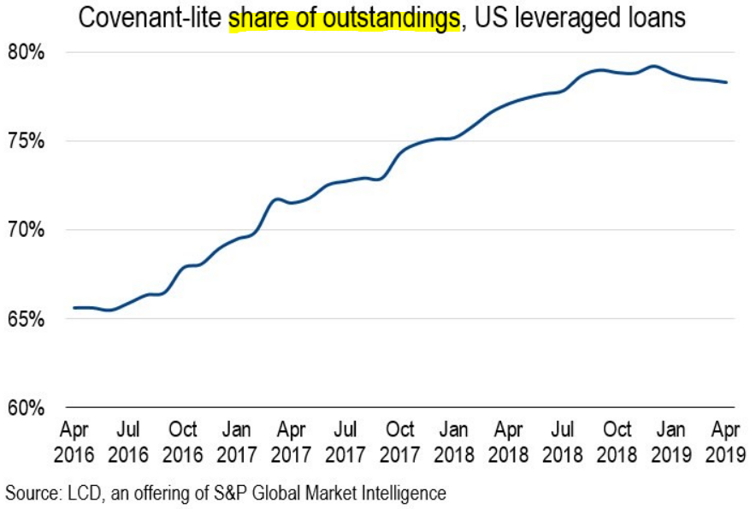
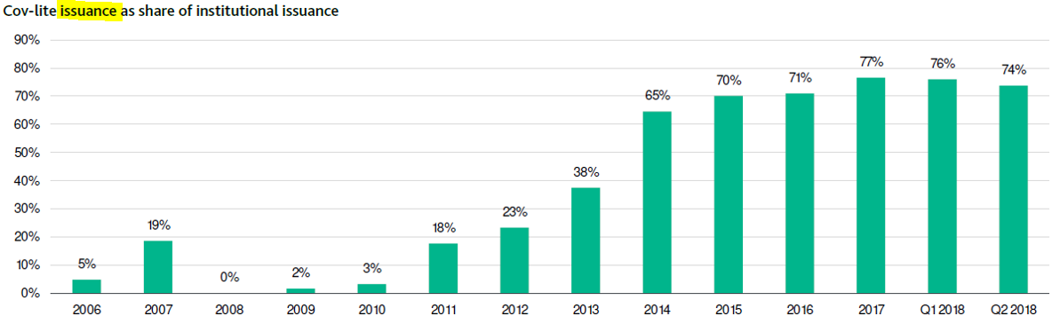
Leveraged Loan Issuance: Ratings, Cov-Lite %
A larger % of leveraged loans is lower-rated
B+ / B / B or CCC:
The % that is “cov-lite” is high
Sources: Morgan Stanley “US Corporate Credit Strategy ChartBook” Sept 30, 2019, Srikanth Sankaran p32;
spglobal.com “Has cov-lite leveraged loan issuance finally peaked?” May 9, 2019

Slide 38
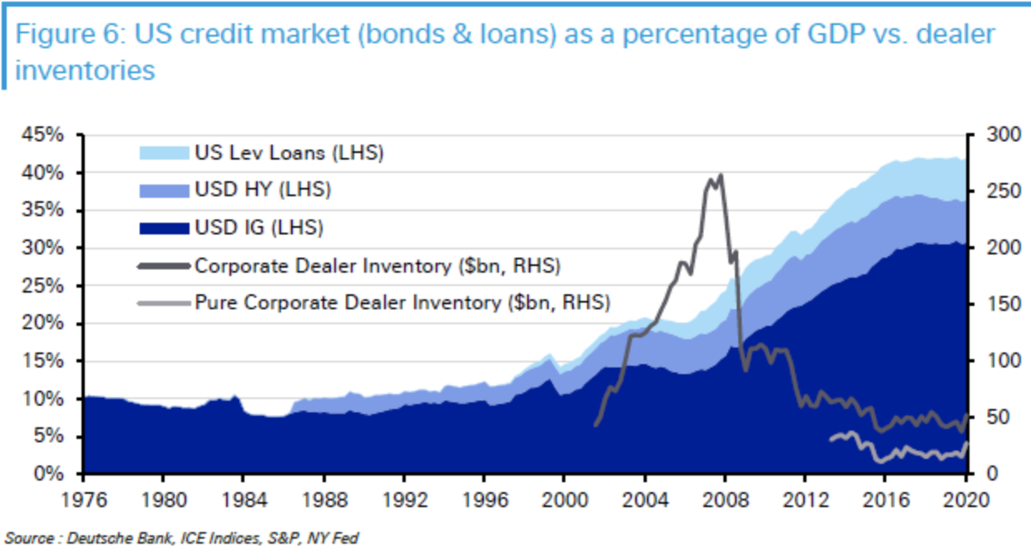
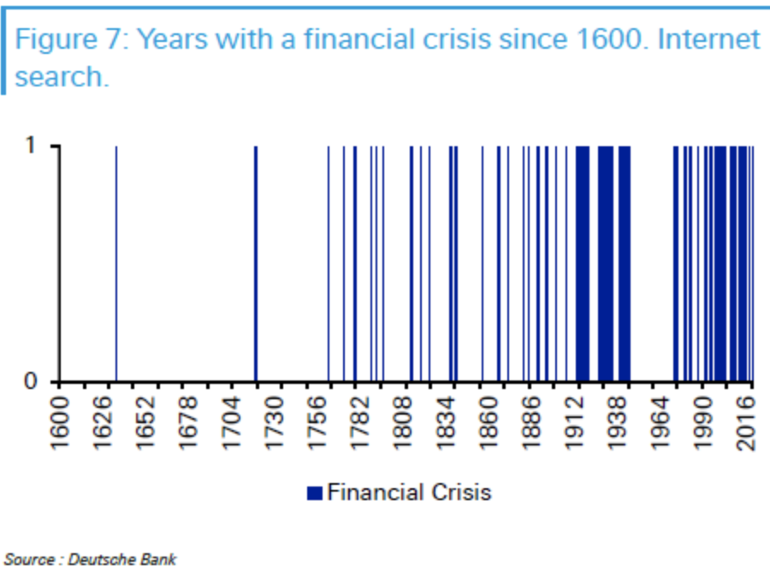
Frequencies of Financial Crisis
Record high debt as % of GDP
And Dealers (BoA, JPM, Citi, GS, MS) reduced holdings significantly
=> do not provide as much liquidity to the markets as they did pre-crisis
Maybe there is a relationship between leverage and the frequency of Financial Crises?
1: WWI, great depression, WWII
2: Post WWII
3: Period of higher leverage
1 2 3
Source: Deutsche Bank Default Study April 2020

Slide 39
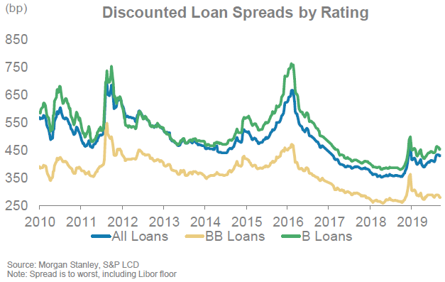
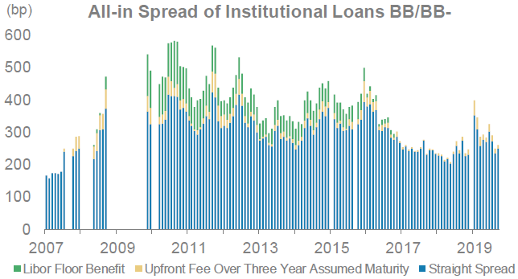
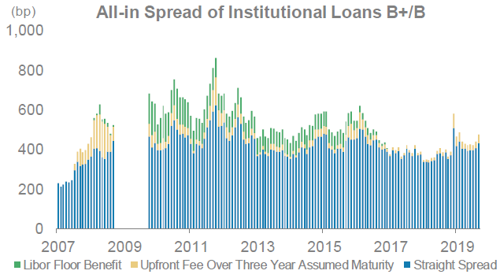
Leveraged Loan: Spreads through late 2019
Spreads on single-B-rated are up since mid-2018
Spreads for BB are close to multi-year tights.
Source: Morgan Stanley “US Corporate Credit Strategy ChartBook” Sept 30, 2019, Srikanth Sankaran p29

Slide 40
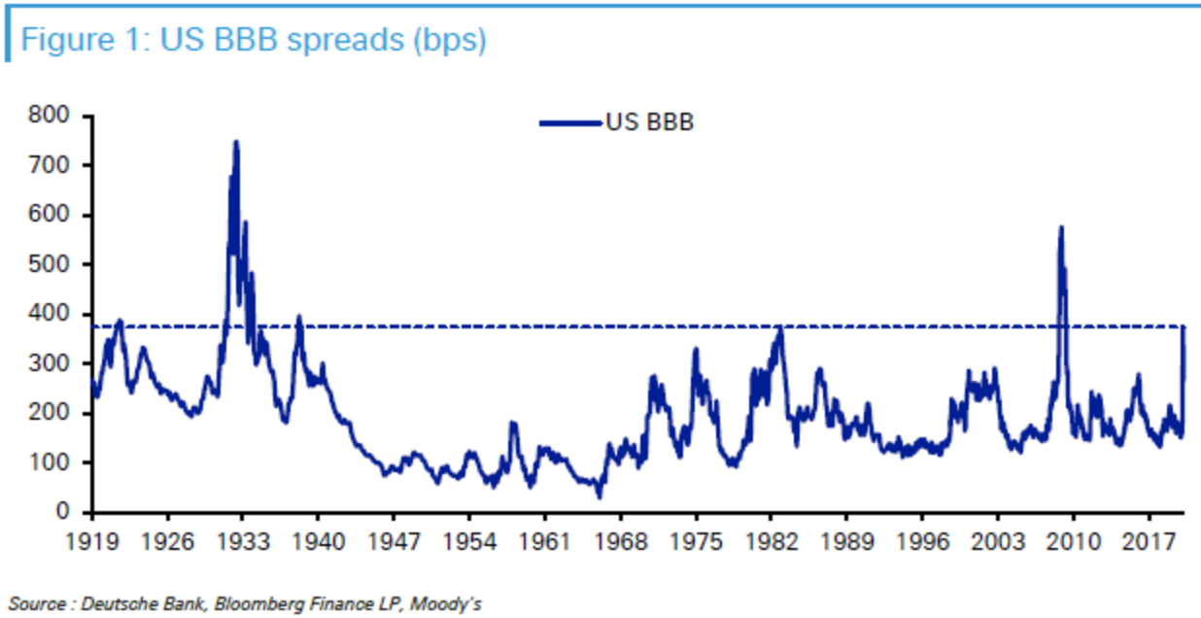
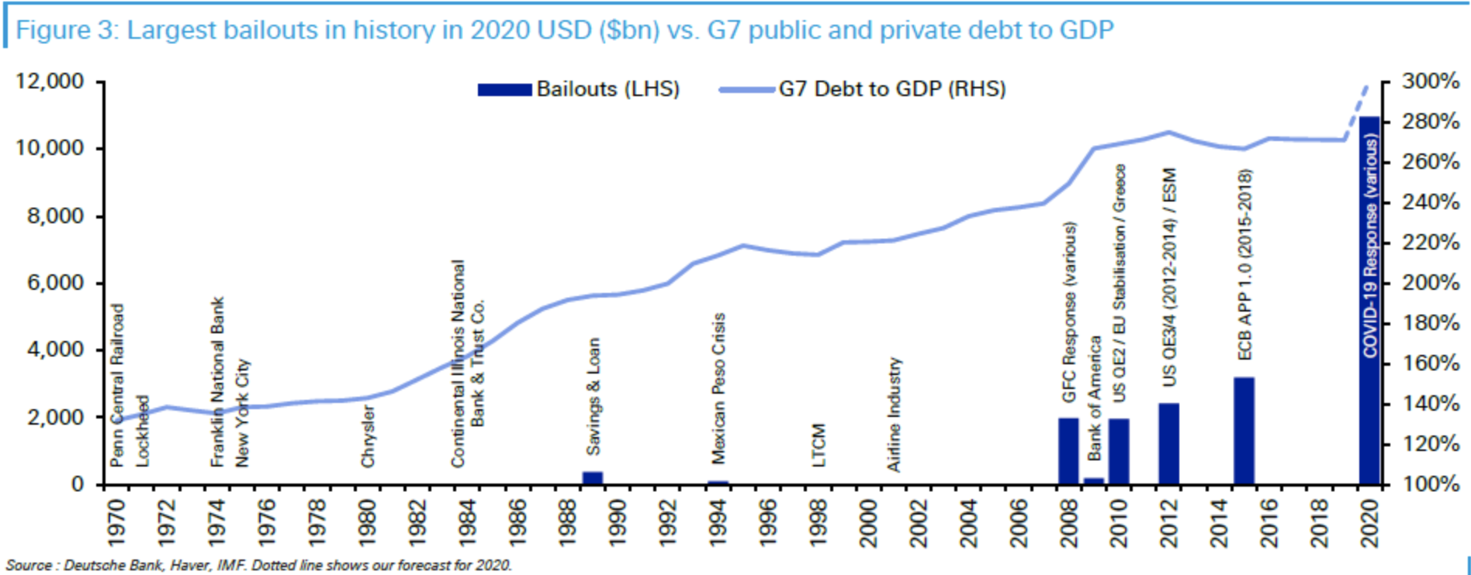
Long-term perspective: U.S. BBB Bond Credit Spreads
BBB spreads blew out
then the FRB stepped in
Source: Deutsche Bank Default Study April 2020

Slide 41
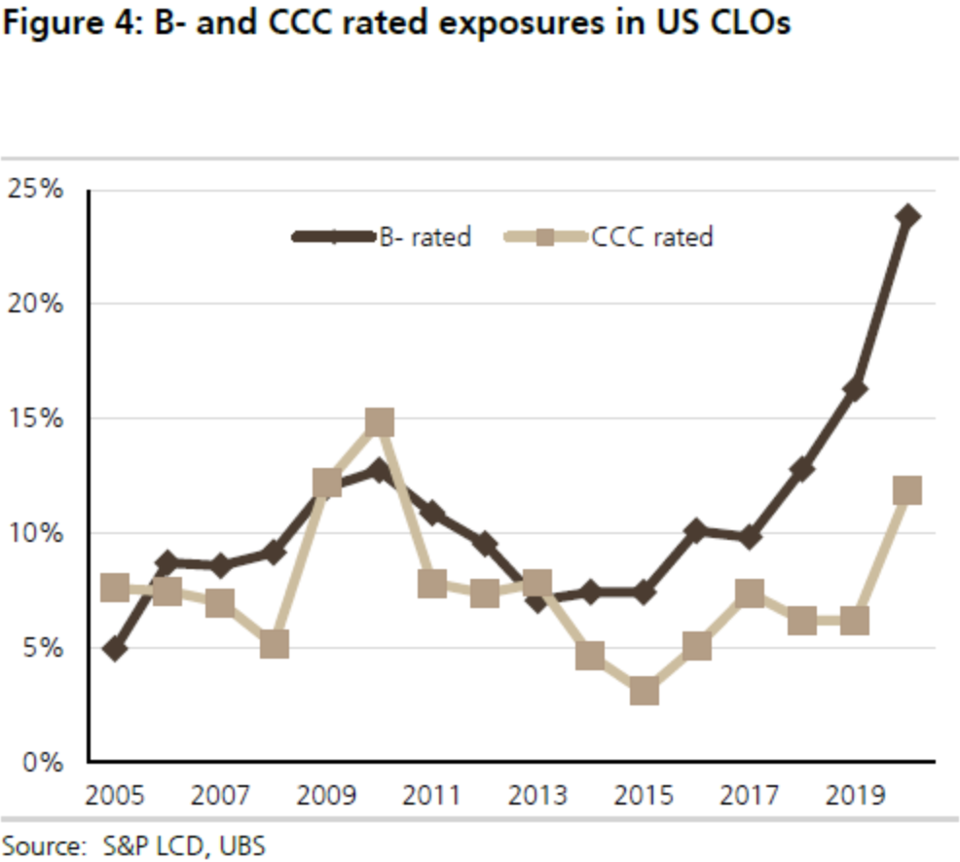
CLO trends
The percentage of lower-rated loans in CLO’s has been growing

Slide 42
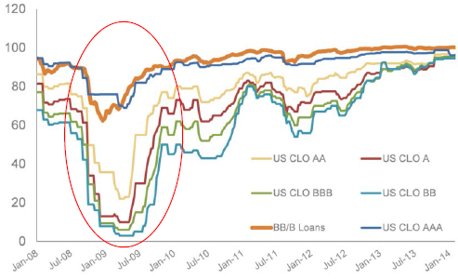
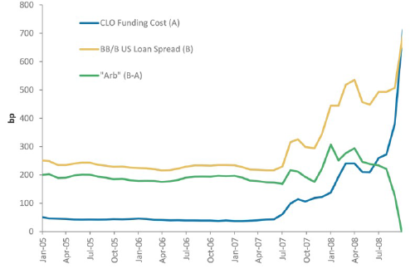
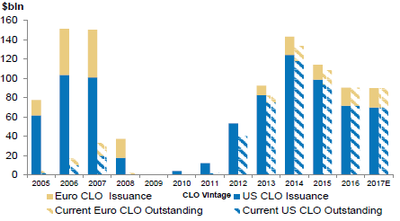
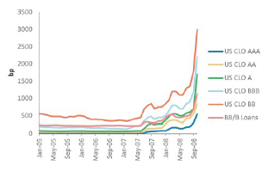
CLO spreads during the Financial Crisis
Spreads during the Financial Crisis
The "Arb" Between Loan Spreads and CLO Funding Costs Vanished
Prices of US CLOs and Loans
CLO Liability Spreads Widened Soon as BB/B Loan Spreads Widened
Global Arbitrage CLO Issuance Volumes
Global CLO Issuance Dried Up in 2008-09 Before Reemerging in 2010
Source: Morgan Stanley Research “CLO Market Primer” Feb 2017, S&P LCD, Intex

Slide 43
CLO: 2020 Yields and Prices
CLO Yields
CLO Prices
Source: Bloomberg

Slide 44
Corporate Loans: A Brief History
<1980s: Banks provide loans to corporate customers, generally on a Bilateral basis (Bilateral = 1 Lender and 1 Borrower). Loans held to maturity (or default!).
Late ‘80s: M&A / LBO Boom required larger loans to “riskier” borrowers resulted in (1) Banks forming groups of lenders – syndicates – sharing the underwriting of large loans and (2) higher yields on these riskier loans attracted non-bank lenders
Early ‘90s: Secondary market for leveraged loans emerges – primarily for distressed loans as banks shed risk
Mid ‘90s: Liquidity expands and market participants worked to create standards in the secondary loan market (documentation standards, settlement rules, pricing services etc)
< Early ‘00s: Non-Bank broker dealers (MS, GS, Lehman, etc) expand Corporate lending origination and trading capabilities to compete with commercial banking “super markets” (Glass-Steagall Act repealed)
‘04-2H07: Bull market, Low default rates, Banks, investors are eager to lend, Borrowers take advantage of favorable terms

Slide 45
Corporate Loans: A Brief History (cont’d)
2H07: Lending slows, credit crunch hits, investors and banks pull back
‘08 – ‘09: Loan volume declines back to levels last seen in the mid 90’s
‘10: Market in recovery mode but still well below peak levels
‘11: Market has shown periods of extreme aggressiveness similar to 2007 but also cautiousness based on macroeconomic concerns
‘12: Market conditions remain frothy
‘13-’14: Market hits new highs, Refinancings/repricings help boost leveraged issuance
‘15/’16: Oil patch hiccup, Refinancings slow but M&A spurs issuance
‘17-’19: Higher leverage ratios, and more “EBITDA adjustments”
‘20: ??????

Slide 46
Leveraged Lending Structural Considerations
Negative covenants
Restricted payments:
To what extent do the restricted payment baskets limit non-accretive outflows (i.e. shareholder dividends, buy-backs, etc)?
How does the relative size of the RP basket compare to similar transactions in the market?
Incremental debt and Liens:
How much additional indebtedness is allowed under the Credit Agreement without Lenders’ consent and why are Lenders comfortable with it?
To what extent can Lenders claims against collateral be diluted via incremental liens?
Asset Disposal:
What are the restrictions on material asset sales?
What percentage of proceeds is required to be re-invested in the business?
To what extent could asset disposals impact Lenders’ expected recovery in a distressed restructuring?
Financial Covenants
Assess financial covenant structure in the context of the following:
Does the financial covenant force meaningful deleveraging and/or support a sustainable capital structure?
What is the likelihood of a financial covenant breach in our projection model?
Prepayment Terms
Do the prepayment terms force meaningful deleveraging and support a sustainable capital structure?
Are the amortization schedule and payment waterfall consistent with comparable transactions in the market?

Slide 47
Leveraged Lending Transaction Diligence Checklist
Core Diligence Checklist:
3 years of audited financials and most recent Year-to-Date (YTD) performance
Bridge from historical financials to year 1 and 2 of projections (Revenues / Operating Earnings or EBITDA / Free Cash Flow)
Commentary on historical performance and projection drivers
Relevant industry trends / themes, including 3rd party reports
Performance during most recent cycle (revenue, EBITDA, EBITDA margin %)
EBITDA and synergies
Bank Group / Modifier:
Agent Bank
Bank group
Historical and Financial Overview:
Historical variance to budget / performance to plan
Year-to-date results / flash results for most recent quarter
Historical Key Performance Indicators (KPIs)
Drivers of historical revenue, EBITDA, Net Working Capital (NWC) and Capital Expenditures (Capex)
Historical liquidity and credit facility utilization
Cash flow seasonality / intra-quarter liquidity needs
Minimum liquidity needed to manage business
Structure / Terms / Distribution:
Full indicative / current term sheet
Debt incurrence / Restricted Payment basket analysis
Flex / pricing / structure flex
Go-to-market provisions (escrow / securities demand)
Industry:
Transaction rationale, if applicable
Competitive landscape
Credit / industry comps
EBITDA and Synergies:
Last Twelve Months (LTM) EBITDA build, with rationale for inclusion / exclusion of each adjustment
Proportion of adjustments as a % of EBITDA
Commentary and expected timing of synergy realization
Fixed vs. variable cost structure
Identification of actions that can be taken within 90-180 days and proportion that is headcount-related
Cost to achieve synergies
Unadjusted leverage
Fully adjusted leverage / marketing leverage
Business Overview:
Key credit risks and mitigating factors
Expected demand patterns within core end markets over next 1-2 years and beyond if available
Foreign exchange exposure
Customer / supplier / regional concentration
Relative competitive positioning
Material developments with respect to major customers / contracts / customer losses
Any material weakness in financial reporting
Legal / environmental / pension / contingent liabilities, if any
Summary view of management
Actions taken since last downturn, if any
Projections:
7 year financial sponsor model assumptions with commentary
Drivers for Revenue
Drivers for EBITDA
Drivers for Net Working Capital / Capital Expenditures
Projected Key Performance Indicators
Detail and support for various components of revenue growth (volume / pricing / market share gains)
Sources of support for projection assumptions (contract waterfall, churn, backlog, new business pipelines, etc.)
Valuation / Capital Structure:
Current leverage and capital structure
Sources and uses of cash
Pro Forma capital structure
Highest leverage, leverage at leveraged buyout (LBO), if applicable
Bankruptcy / distressed exchange history
Pro Forma valuation and implied equity cushion

Slide 48
Leveraged Lending: Regulatory
Leveraged Lending – Regulatory Guidance:
The U.S. Banking Regulators, namely the Office of the Comptroller (OCC) and the Federal Reserve, introduced the guidance in 2013 in the wake of the financial crisis
The guidance caps pro forma leverage for leveraged financings at 6x and also requires that a company be able to amortize at least 50% of its debt within 5 – 7 years of closing
Guidance has precluded banks and sponsors from undertaking certain deals given scrutiny from regulators focused on leverage and strength of loan covenants

Slide 49
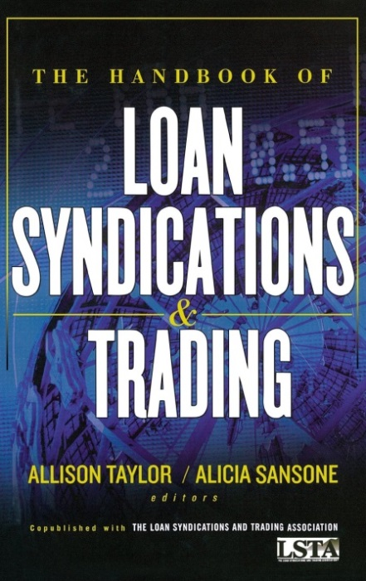
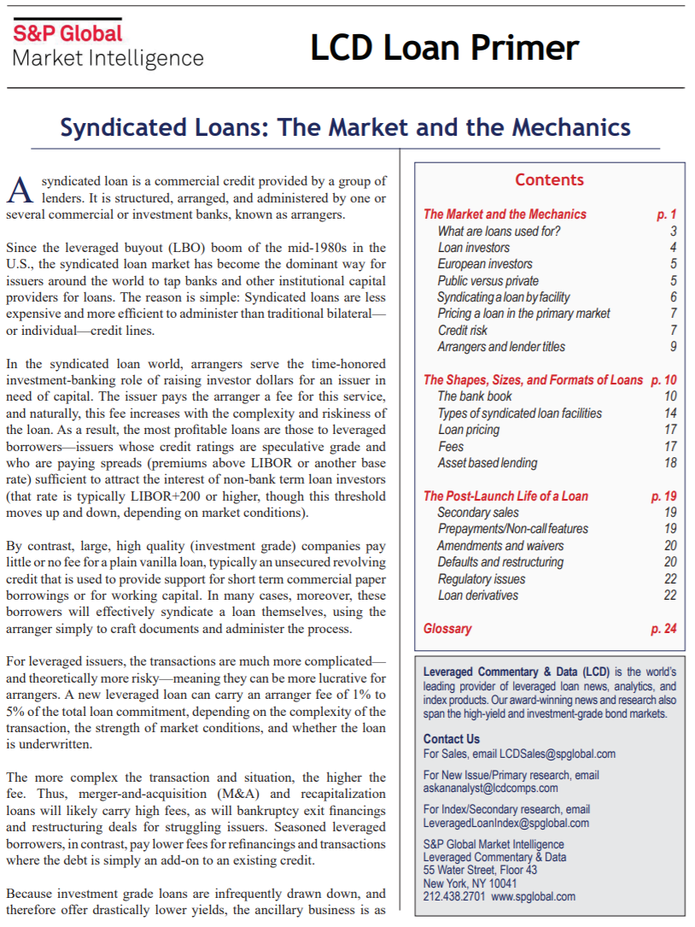
Corporate Loans – Resources
S&P Global Market Intelligence “LCD Loan Primer | Syndicated Loans: The Market and the Mechanics” 2017
https://www.spglobal.com/marketintelligence/en/pages/toc-primer/lcd-primer#sec1
The Loan Syndications and Trading Association: www.lsta.org
Standard and Poor’s Leveraged Commentary & Data (“LCD”): www.LeveragedLoan.com

